Slide 1
LEP Developing English Virtual Learning
Mr. Rodríguez, Mrs. Gotzon, Ms. Niehues
April 21, 2020

Slide 2
9-12/LEP Developing English
Teens Open Doors (Part I): April 21, 2020
Objective/Learning Target:
Understanding cause and effect
Learning the proper uses of antecedents

Slide 3
Bellringer
Practice Key Vocabulary
Choose the correct vocabulary term for each definition.
assemble technology obstacle efficient
______ Scientific knowledge
______ Works well without waste
______ To put something together
______ Something that is in the way

Slide 4
Listen and read along with today’s reading from “Teens Open Doors”.

Slide 5
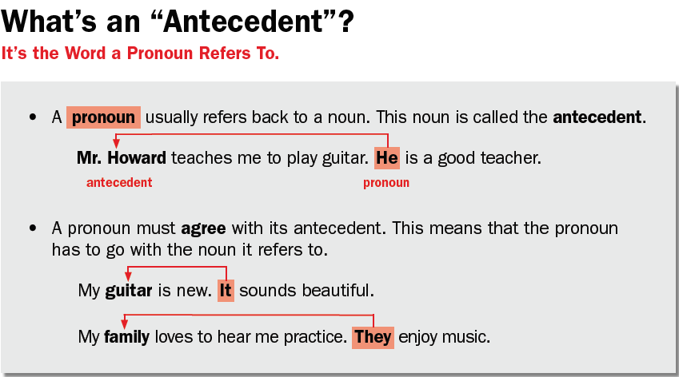
Focus on GRAMMAR:
Read through the example to understand what an antecedent is.
Why are antecedents important to use?

Slide 6
Try it out for yourself!

Slide 7
